Slide 1
ODC Agile Journey

Slide 2
Agenda
Where we are
Challenges
Solutions
Trust Agile

Slide 3
Where we are
Daily standup meeting
Postmortem meeting (retrospective meeting)
Time Box (Flexible Time box)
Tasks Assignments (PM assign)
Test Efficiency (Manual)
Skills Diversity (Limited)

Slide 4
Challenges – Time box Lack of rhythm
Background: The schedule/plan is given on the estimation; thus time box is variable.
Impact:
Team member self involvement in planning
Propagate Motivation

Slide 5
Challenges – Task assignment
Background: PM assigned the tickets based on developer’s capability and bandwidth.
Impact:
Proactive
Self organize
Team improvement

Slide 6
Challenges – Manually test
Background: Regression test is made manually.
Impact:
Limited regression coverage(Might escape bugs to production)
Team member fears changes

Slide 7
Challenges – Limited Skill Diversity
Background: When teams transition to Agile there still handoffs from dedicated roles, such like BA, UI, BW, FE, QA.
Impact:
More bottleneck
Work in parallel
Self skill improvement
Project speed improvement
Notes:
Scrummerfall and Waterations – When teams first transition to Agile there often still handoffs from BA –> UI –> Dev –> QA. As you can see this is still waterfall only faster i.e. waterfall in two weeks. While this is an improvement the real wins in Agile come when work in parallel and blur role boundaries. Work in parallel includes Acceptance Test Driven Development, where the acceptance tests are written before the application code. Agile encourages the blurring of role boundaries with Generalizing Specialists, in this case we might see a BA who learns enough about QA to help write tests cases or a developer who learns enough about UI work to create the initial mockup before finding the UI specialist.

Slide 8
Solutions – Fixed time box & More team involvement in Planning
Solution:
Arrange a fixed time box
Let the team to plan the project scope
Initially we can try time boxes with each fixed 2 weeks(Regardless the total duration of estimation).
Let team to decide which should be implemented first in different sprint.
Through a fixed time box we can see whether the team production is actually improving by looking at the total tickets size in each sprint.
Overall speaking, we can compare the total cost with rough estimate and observe if fixed time box is more productive(In a longer term)

Slide 9
Solutions – Take task instead of Assign task
Solution:
Team members are encouraged to take the task by themselves. By observing this activity we can see who likes the challenging task and who is more conservative. Thus we know people’s different characteristics in order to help scrum master to communicate with them in the team. We also want to see the people can collaborate with others to accomplish the tasks.
We shall set up the role model in the team to promote the sprite to be more brave to take the difficult work.
For these person who scare to take challenging task, sometimes we have to assign the task to them. The difficulty level can be gradually improved.
Notes:
There are some cases. E.g. a task which can be done in implementation, but QA doesn’t have the time to test all the test cases in this sprint. Let’s say customer wants this ticket. By observing the discussion we can observe what action team members response. Will someone raise his hand to be QA or other suggestions? We encourage people can fill in other roles. Through the project practice they can have multiple skills.

Slide 10
Solutions – Automation Regression Test
Automation test is the key success to agile. Therefore, we have to focus on it if we want to have the real agile practice.
Solution:
Write the necessary UT test code firstly
Build Automation Regression Testing Scripts for OP
Provide the training to all team members

Slide 11
Solutions – Create opportunity to learn new skills
As agile requires people to have the multifunctional skills, we should gradually blur of role boundaries with Generalizing Specialists (FE, BW, QA, UI).
Solution:
Team members share their perspective view in different role (e.g. QA can share her view how to test a particular function.)
Give practice opportunity to team members to take other roles during the project (time pressure, resource lack)
Summarize the best practice and lesson learned

Slide 12
Trust Agile And Enjoy Journey
Believing that your done becoming Agile – An Agile transition is a journey, one that you never really complete. You will always find ways to improve and new experiments to be run. If you keep an open mind and are always looking for new ideas you will undoubtedly scale new heights.

Slide 13
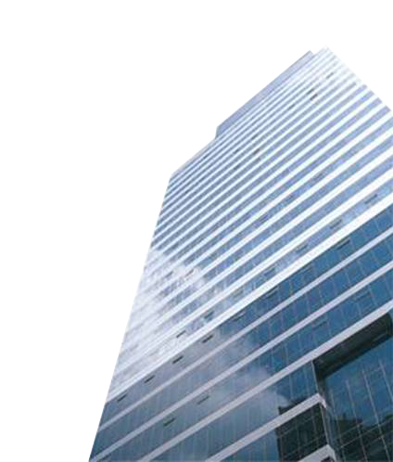
Q&A
Thank you
Bleum Global Headquarters
Cloud-9 Mansion 8F 1118 West Yan’an Road Shanghai, 200052 PRC Tel: +86 (21) 6282 1122
www.bleum.com
Notes:
13

